Slide 1
We have stated that science is really just a body of knowledge.
We have also mentioned that science involves a systematic way of understanding structure and behavior of the physical and natural world through observation and experimentation.
Chapter 1.3

Slide 2
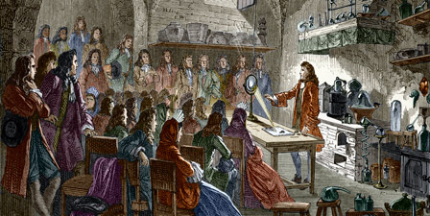
How do we get this knowledge and how do we know it is true and accurate?
Beginning in the 17th Century, a method started to be developed to solve problems and gather data about the physical and natural world. Today we call it the:
Scientific Method

Slide 3
Scientific Method can be defined many ways but all have a central theme:
A systemic approach to investigation in which a question is first identified through data gathered from observations.
The answer to the question is then proposed in a hypothesis.
The hypothesis is then tested, the results collected, analyzed, communicated, and the new data should all be able to be repeated by others.

Slide 4
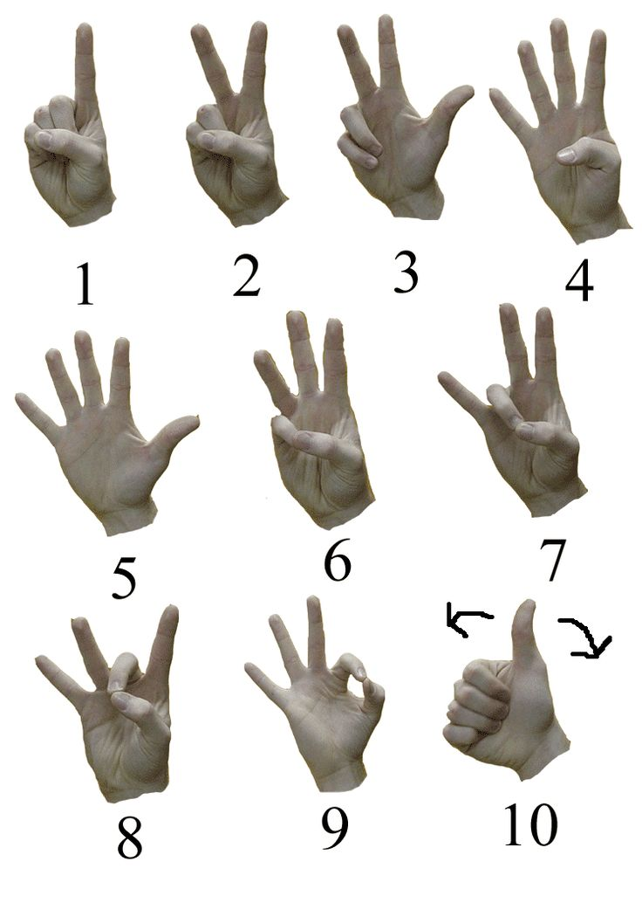
Steps of the Scientific Method:
Observations
Question
Hypothesis
Investigate (experiment)
Evaluate results
Communicate findings
____________________________________________________________
____________________________________________________________
____________________________________________________________
____________________________________________________________
____________________________________________________________
____________________________________________________________

Slide 5
Observation
- direct observation (include all 5 senses)
Those that can be seen, heard, tasted, touched or smelled
Example: smell a rose, hear a bird chirping, read a book
- indirect observation
Those that cannot be seen, but their effects can be seen.
Example: - you tripped and gravity caused you to fall
- wind blew the papers all over the place
Click

Slide 6
2. Observations lead to Questions
After making some initial observations of the world around you.
Form a question you would like to be answered.
Example:
Observation 1 – During basketball practice my heart rate appears to increase.
Observation 2 – When resting after practice my heart rate appears to go down.
Question: Does exercise affect heart rate?

Slide 7
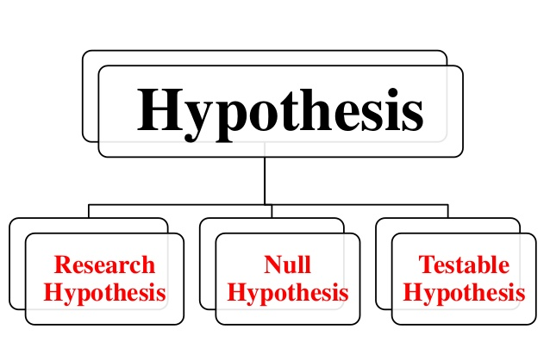
3. Hypothesis
In science, a prediction known as a hypothesis is made to
help explain one possible answer to the question.
_________________________________________________________________________________________
_________________________________________________________________________________________
_________________________________________________________________________________________
_________________________________________________________________________________________
Criteria for a valid hypothesis:
It MUST be a statement.
It MUST be testable.
It MUST be specific to and answer your question.
Hypothesis = singular
Hypotheses = plural

Slide 8
Which of the following are valid hypotheses concerning our exercise question?
1. Will exercise increase my heart rate?
2. If I exercise, then my heart rate will increase.
3. If I exercise, then my heart rate will decrease.
4. If exercise increases my heart rate, then I will be hungry.

Slide 9
4. Investigate
An investigation is a systematic study of the facts or finding new information about a particular truth.
Scientists perform investigations by using:
A. Controlled experiments
B. When performing an experiment is not possible or
unethical, a Study can be performed to test a
hypothesis.

Slide 10
A. Controlled Experiments
A controlled experiment tests only ONE factor at a time while
keeping all other factors the same.
Typically there two groups:
1. Control group – gets no experimental treatment.
2. Experimental group – gets all the same factors as the control
group but also receives the one tested factor.
The single factor being tested is known as the independent variable.
Factor that changes in response to the independent variable is known as dependent variable.
______________________________________________________________________________________________
______________________________________________________________________________________________
______________________________________________________________________________________________
______________________________________________________________________________________________
______________________________________________________________________________________________
______________________________________________________________________________________________
______________________________________________________________________________________________

Slide 11
B. Research Study
In a Study, researchers gather information from various sources and attempt to find trends in the data collected.
The researchers will try to limit the number of variables (factors) that can affect their data.

Slide 12
5. Evaluate
During an investigation data (evidence) will be collected which will help you draw an informed conclusion whether your hypothesis was valid or not.
Types of Data
Quantitative data – data that can be measured and will produce a number.
Qualitative data – data that does not produce a number.
_________________________________________________________________________________________
_________________________________________________________________________________________
_________________________________________________________________________________________
_________________________________________________________________________________________
Whichever type is collected these results must be analyzed using indices, graphs, charts or other statistical tests.

Slide 13
6. Communicate findings
In the final evaluation, conclusions are drawn based on the newly found evidence.
The hypothesis is checked whether it is supported by the evidence or not supported by the evidence.
Bias must be excluded from any conclusions. Bias is showing favor to one bit of data over another or throwing out evidence that does not fit the hypothesis.
______________________________________________________________________________________________
______________________________________________________________________________________________
______________________________________________________________________________________________
Whether the investigation supported the hypothesis or did not support the hypothesis, the new evidence and conclusions must be communicated to others.

Slide 14
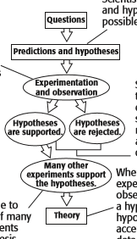
Scientific Theory
The difference between a theory and a hypothesis is:
A hypothesis is a specific, testable prediction for a limited set of conditions.
A theory is the generally accepted explanation for a broad range of current data and observations.
_____________________________________________________
_____________________________________________________
_____________________________________________________
_____________________________________________________

